Slide 1

DEEP DIVE TRAINING MODULES
Resilience in F&B sector

Slide 2
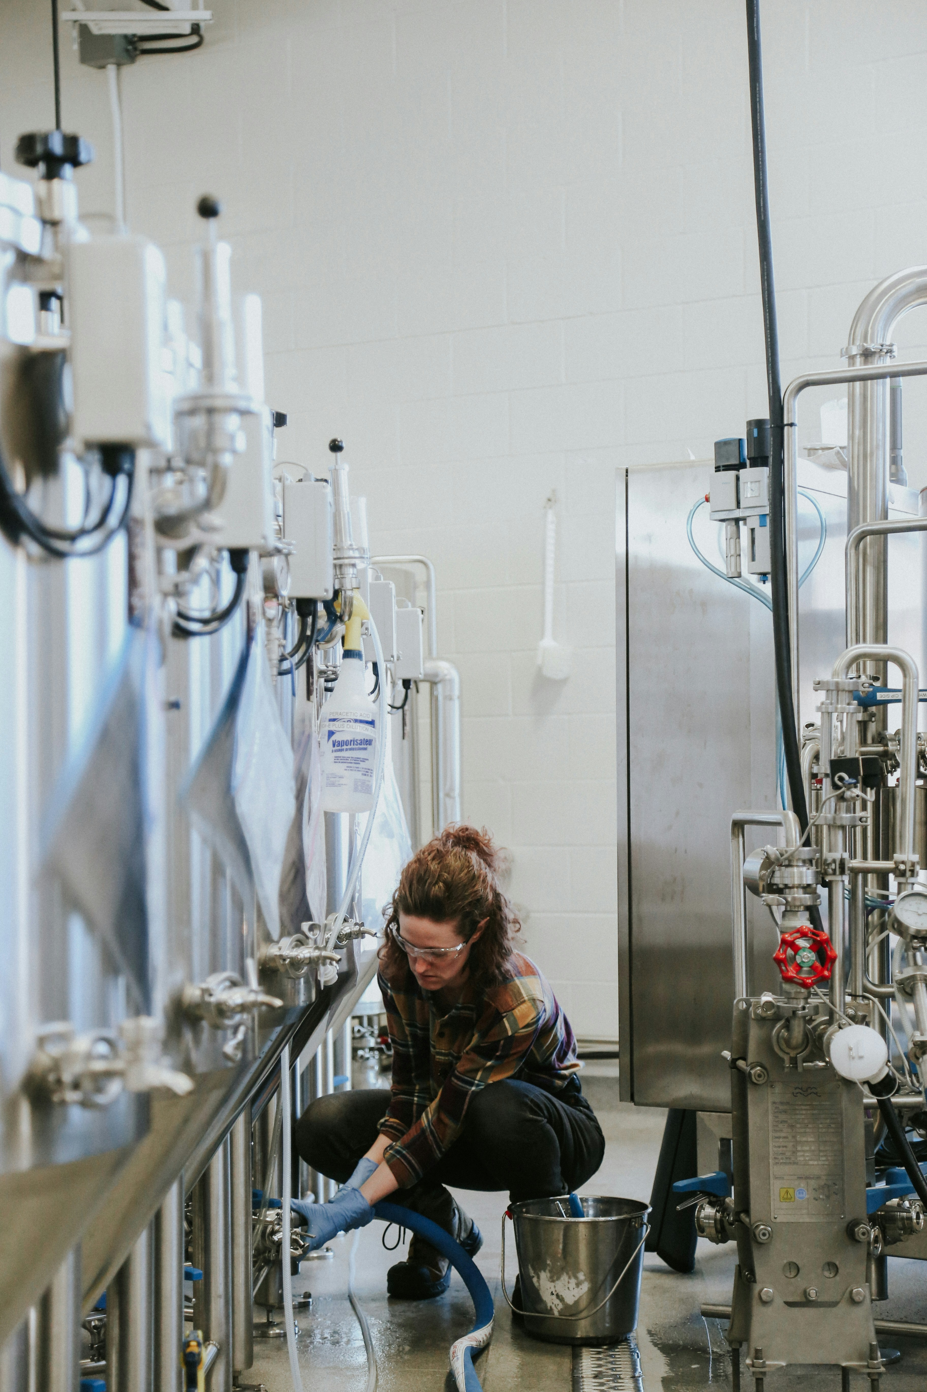
Part 2
Why does resilience matter
in the F&B sector?
This part will explain why resilience is important in business today and how it is important for F&B sector.
It will support:
Understanding the relationship between resilience and business survival​
Understanding resilience context in F&B sector

Slide 3
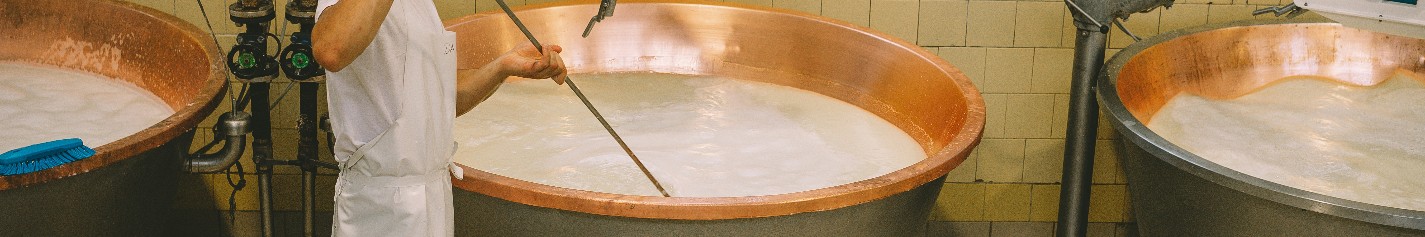
CONTENTS
01
Need for business resilience
02
What is resilience and why it matters
03
Need for resilience in F&B sector
Notes:
This session is followed by a practical discussion on enhancing resilience and developing a forward-thinking mindset among the participants.

Slide 4
Before going further, think…
Do you run your own business?
Did you ever run your own business?

Slide 5
Before going further, think…
What is challenging about running a business?

Slide 6
That’s why business organizations need
RESILIENCE

Slide 7
What is Resilience?
Resilience is the ability to adapt to, withstand, and recover from adversity, effectively "bouncing back" from difficult experiences.
Resilience is the capacity to adapt successfully in the face of threat or disaster.
Notes:
What is Organisational Resilience?
The official definition from ISO 22316 describes organisational resilience as the ability of an organisation to absorb and adapt in a changing environment, to deliver its objectives, and to survive and prosper.
Think of a tree in a storm. A rigid tree might break under the pressure of strong wind, but a flexible one bends and adapts. In the same way, resilient organisations are not the ones that are simply strong, but the ones that are flexible, adaptive, and able to learn from crises.
Resilience vs Business Continuity vs Risk Management
Now, resilience is often confused with related concepts like business continuity or risk management.
Risk management is about identifying risks and reducing the likelihood or impact of negative events.
Business continuity is about having plans in place to keep essential operations running during a disruption.
Resilience, however, is broader – it’s about building an organisation that is inherently adaptive and capable of emerging stronger after disruptions.
For example, during the COVID-19 pandemic, many companies had business continuity plans to deal with short disruptions. But only resilient companies – like those able to quickly shift supply chains or launch new digital services – managed not just to survive but also to grow.

Slide 8
Why Resilience Matters Today?
Fast-changing environment
?????
Global supply chain vulnerabilities
?????
Increased Dependence on technology

Slide 9
Why Resilience Matters in F&B sector?
Lockdowns during Covid-19 pandemic affected dramatically sales in restaurants, cafees, bakerys
Cheap food in supermarkets caused rapid sales decrease in many bars, local bakery’s
Crisis-led changes in basic salaries affected small local restaurants cost effiencies
Brexit-caused sudden regulatory changes disrupted food exports/imports between UK and EU
Climate change-affected droughts in Spain caused shortages of olive oil and vegetables in Europe

Slide 10

Deep dive into understanding of resilience constraints in F&B SMEs
- watch video case studies

Slide 11


Follow our journey
l
in
f
www.DIGIFABS.eu

