Slide 1

DEEP DIVE TRAINING MODULES
Resilience in F&B sector

Slide 2
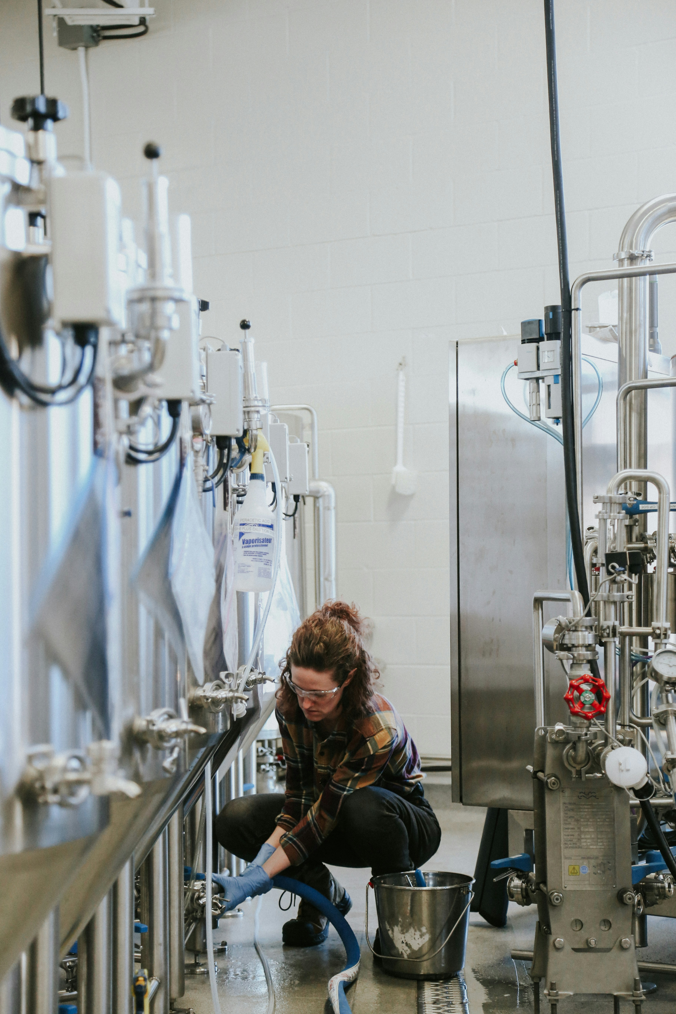
Part 3
Digitalization and resilience
– discussion forum
This part will discuss the relationship between digitalization and resilience, highlighting real challenges and benefits.
It will support:
Understanding the role of digital technologies in responding to market disruptions​, and enhancing organisational resilience

Slide 3
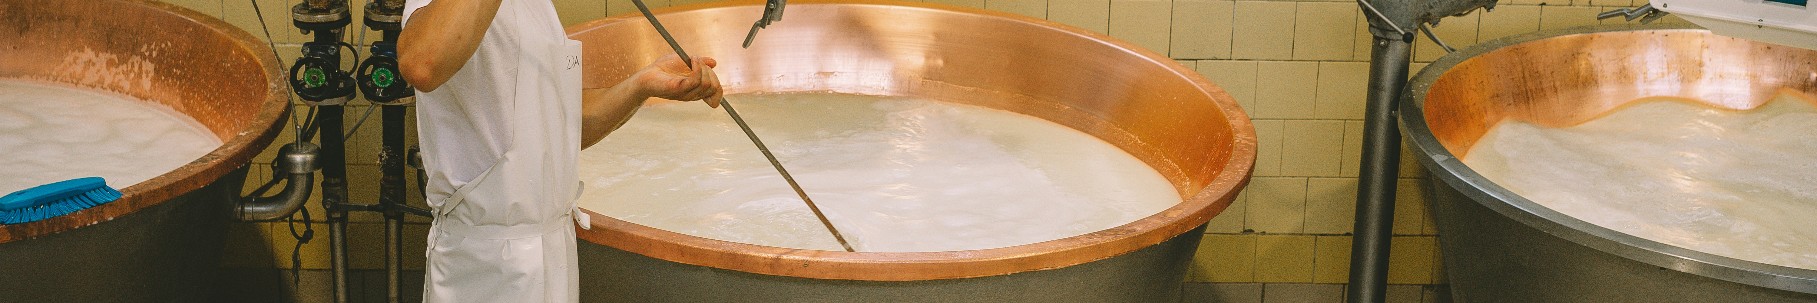
CONTENTS
01
Market changes and the need for response
02
Digitalisation support
03
Digitalisation challenges and benefits
Notes:
This session is followed by a practical discussion on enhancing resilience and developing a forward-thinking mindset among the participants.

Slide 4
DISCUSSION FORUM
Guests:
XXXXX – IT systems consultant, F&B production systems
XXXXX – IT systems consultant, F&B operation management systems
XXXXX – IT systems educator
XXXXX – innovation & technology trainer
Everyone is invited to ask questions
and share interesting insights
Notes:
This framework provides instructions on the topics important for discussion and the type of experts that could be potentially involved. The list may be modified, depending on conditions. It is advised to hold a discussion forum with digitalization and innovation experts, although the participation of students themselves is also valuable. Training participants may be also invited to look for answers by themselves. An example of such a discussion is provided in video in this section.

Slide 5

DISCUSSION FORUM
What is the general attitude of F&B companies to business digitalisation, what different strategies can be applied, and how does it impact organisational resilience?
Does this attitude change over time? How?
Notes:
Sharing own perspectives, providing examples

Slide 6
DISCUSSION FORUM
What are the main challenges when implementing IT systems / digital solutions in F&B sector?
What is the role of resistance? How important is Digital Mindset – of individuals and organisations?
What competences should be developed or acquired to navigate digital transformation smoothly?
Notes:
Sharing own perspectives, providing examples

Slide 7
DISCUSSION FORUM
Participants questions
and comments?
Notes:
Sharing own perspectives, providing examples

Slide 8
DISCUSSION FORUM
How could young digital change agents seize the best opportunities for F&B companies’ digital transformation to build their organisational resilience?
What’s your recommendation?
Notes:
Sharing own perspectives, providing examples

Slide 9
DISCUSSION FORUM
What arguments can the young digital change agents use to convince F&B companies’ business owners to drive digital transformation, which will contribute to building their organisational resilience?
Notes:
Sharing own perspectives, providing examples

Slide 10


Follow our journey
l
in
f
www.DIGIFABS.eu

