Slide 1

DEEP DIVE TRAINING MODULES
Resilience in F&B sector

Slide 2

Part 5
Resilience strategy
for F&B sector
This part discusses the role of Resilience strategy in driving F&B business operations and development. It highlights the role of digital enablers in capturing risk-based growth opportunities.
It will support:
Understanding on how to transform risk situations into growth opportunities in F&B business with digital solutions support

Slide 3

CONTENTS
01
Organizational resilience landscape in F&B sector
02
Digital solutions as resilience enablers
03
Resilience Strategy

Slide 4
What is Organisational Resilience?
Resilience: the ability of an organisation to absorb and adapt in a changing environment to deliver its objectives and to survive and prosper.”
Resilience ≠ Business Continuity ≠ Risk Management
Risk management is about identifying risks and reducing the likelihood or impact of negative events.
Business continuity is about having plans in place to keep essential operations running during a disruption.
Notes:
What is Organisational Resilience?
The official definition from ISO 22316 describes organisational resilience as the ability of an organisation to absorb and adapt in a changing environment, to deliver its objectives, and to survive and prosper.
Think of a tree in a storm. A rigid tree might break under the pressure of strong wind, but a flexible one bends and adapts. In the same way, resilient organisations are not the ones that are simply strong, but the ones that are flexible, adaptive, and able to learn from crises.
Resilience vs Business Continuity vs Risk Management
Now, resilience is often confused with related concepts like business continuity or risk management.
Risk management is about identifying risks and reducing the likelihood or impact of negative events.
Business continuity is about having plans in place to keep essential operations running during a disruption.

Slide 5
What is Organisational Resilience?
Resilience goes beyond survival → focuses on using risks as growth opportunities.
Resilient organisations embrace risks as drivers of innovation.
Example opportunities:
Food safety regulation → drive premium “certified safe” product lines.
Consumer diet shifts → develop plant-based alternatives.
Supply chain risks → local sourcing strategies.
Notes:
Resilience, however, is broader – it’s about building an organisation that is inherently adaptive and capable of emerging stronger after disruptions.
For example, during the COVID-19 pandemic, many companies had business continuity plans to deal with short disruptions. But only resilient companies – like those able to quickly shift supply chains or launch new digital services – managed not just to survive but also to grow.

Slide 6


Examples
Beyond Meat (USA): The declining trust in red meat due to health concerns and environmental impact was a consumer demand risk for the traditional meat industry. Beyond Meat turned this risk into a business opportunity by introducing plant-based protein alternatives. They leveraged consumer concerns to create a new, fast-growing market segment.

Slide 7
Examples
Arla Foods (Denmark, cooperative of 0ver 9,000 farmers): faced severe drought in Northern Europe in 2018, leading to reduced milk production due to lack of feed and water. This was an environmental risk with high impact. Arla responded by introducing water-saving initiatives and investing in feed alternatives. They also supported farmers financially and with advisory services. Arla used this risk to invest in sustainable practices to protect future supply.

Slide 8
Examples
Danone (France) during COVID-19: when restaurants and schools closed, a huge part of the dairy product demand disappeared almost overnight. Instead of cutting production drastically, Danone re-routed milk and yogurt distribution toward retail chains and online delivery services. They also accelerated e-commerce platforms and partnered with local food delivery companies. This not only kept supply chains running but also opened new, long-term sales channels. The disruption became an opportunity to strengthen Danone’s retail and digital presence.

Slide 9
Digital Solutions as Resilience Enablers
ERP systems simplify day to day operations, integrate finance, HR, supply chain, operations.
Blockchain ensures transparency & immutability of records (food and ingredients supply chain transparency)
IoT sensors enable predictive maintenance and real-time monitoring (real-time monitoring of food safety & Logistics)
AI & predictive analytics enable demand forecasting.
Cloud computing supports scalability and remote collaboration.
Cloud platforms enable remote collaboration & continuity.

Slide 10
Examples
Nestlé (Switzerland): The company faced major reputational risks around the sourcing of palm oil. NGOs accused Nestlé of contributing to deforestation. This wasn’t a direct operational disruption, but it threatened consumer trust and long-term sales. Nestlé responded by implementing blockchain-based traceability systems, making it possible to track palm oil from plantation to product. Nestlé transformed a potential crisis into a chance to strengthen brand credibility and sustainability.

Slide 11
Examples
Carrefour (France): launched blockchain traceability for chicken, eggs, and milk. Consumers could scan QR codes on packaging and see the product’s full journey – from farm to shelf. This reduced consumer trust risks by ensuring transparency. For Carrefour, digitalisation not only solved a risk but also became a marketing advantage – shoppers perceived the brand as more trustworthy and innovative.

Slide 12
What is a Resilience Strategy
Having Resilience Strategy in place might help to use risks as opportunities and to stimulate the organisation’s growth.
Resilience Strategy: structured approach to prepare, respond, adapt, and grow during disruptions.
Elements of Resilience Strategy
Risk assessment (probability × impact).
Risk mitigation strategies
Risk-based growth opportunities
Resources and strategies to act on opportunities
Digital technology enabling resilience

Slide 13
Step 3: Risk-Based Growth Opportunities
Not all risks are negative – some create opportunities.
High-likelihood risks often signal shifting markets.
Opportunities can include:
  Developing new products.
  Entering new channels, markets (e-commerce, local sourcing).
  Building customer trust with transparency sustainability.
Food sector example:
Beyond Meat used declining trust in red meat (risk) as an opportunity to grow the plant-based protein market.
Nestlé turned sustainability risks into new product lines (certified sustainable coffee and cocoa).

Slide 14
Step 4: Resources & Strategies to Act on Opportunities
Any action needs resources!
Resources required:
  Financial: investments, insurance.
  Human: skilled teams, training.
  Technological: digital tools, data systems.
  Partnerships: suppliers, local communities, governments.
Strategies: phased investments, pilot projects, strategic alliances.
Food sector example:
Danone mobilised resources to expand e-commerce:
  Financial: redirected budget from traditional marketing to online.
  Human: trained sales teams in digital channels.
  Partnerships: worked with food delivery platforms.

Slide 15
Step 5: Digital Technology Enabling Resilience
Technology as a resilience enabler: support for opportunities capturing
There are plenty options
The main challenge is wchich options should be chosen
Food sector example:
Carrefour: blockchain for transparency.
Unilever: AI-based forecasting improved ice cream distribution during supply chain disruptions.
Danone: IoT sensors ensured food quality despite transport delays.

Slide 16
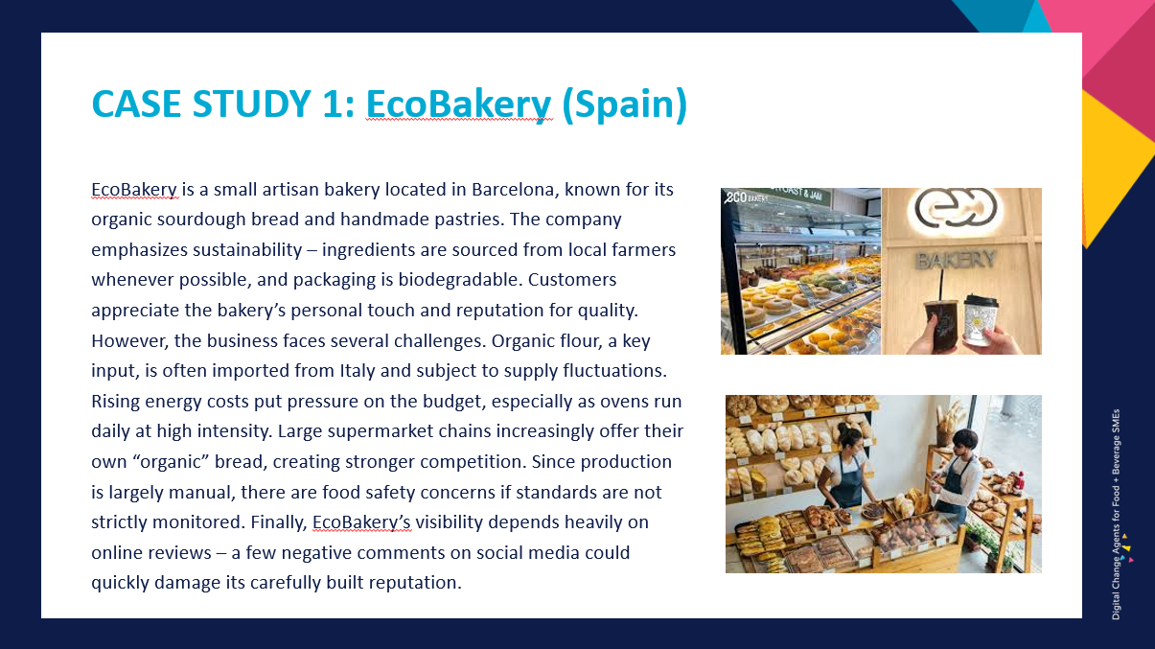
Let’s get back to EcoBakery example

Slide 17
RISK MITIGATION AND ASSESSMENT STRATEGIES
- as defined already in part 4

Slide 18
Resilience Strategy
- transforming risks and envisioning a digitally supported future
Now turn risks into
actionable
growth opportunities

Slide 19
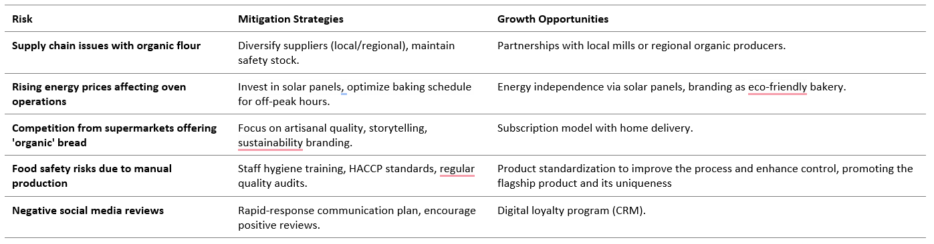
RESILIENCE STRATEGY
turning risks into growth opportunities

Slide 20
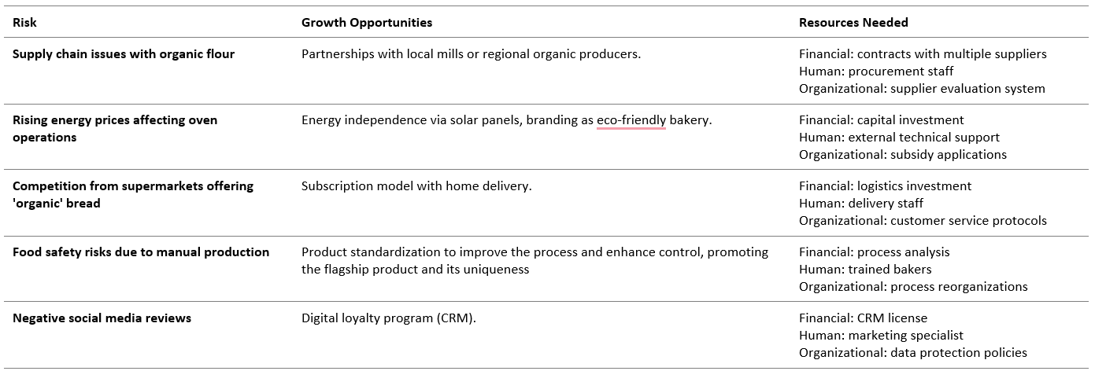
RESILIENCE STRATEGY
- defining resources needed to grasp growth opportunities

Slide 21
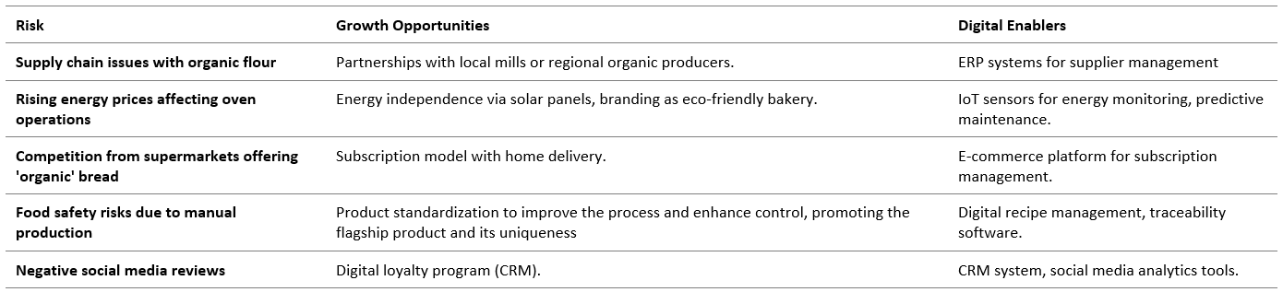
RESILIENCE STRATEGY
- defining digital enablers to grasp growth opportunieties

Slide 22
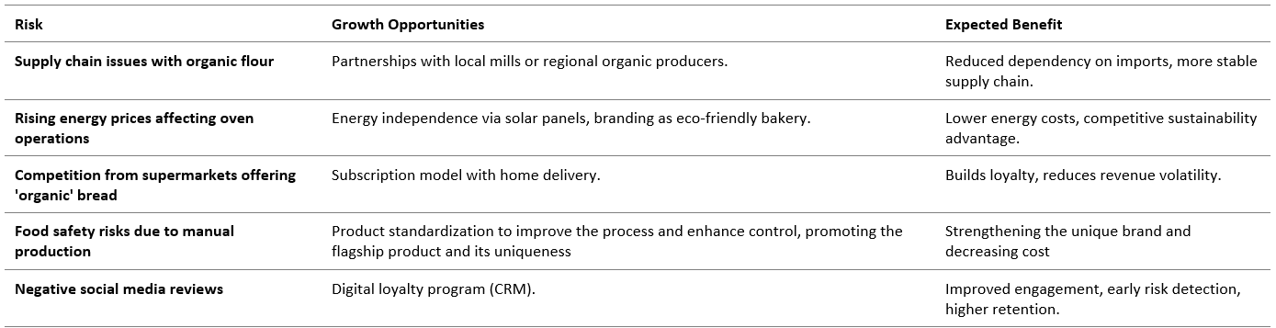
RESILIENCE STRATEGY
- assessing potential benefits from the transformation of risks into growth opportunities

Slide 23
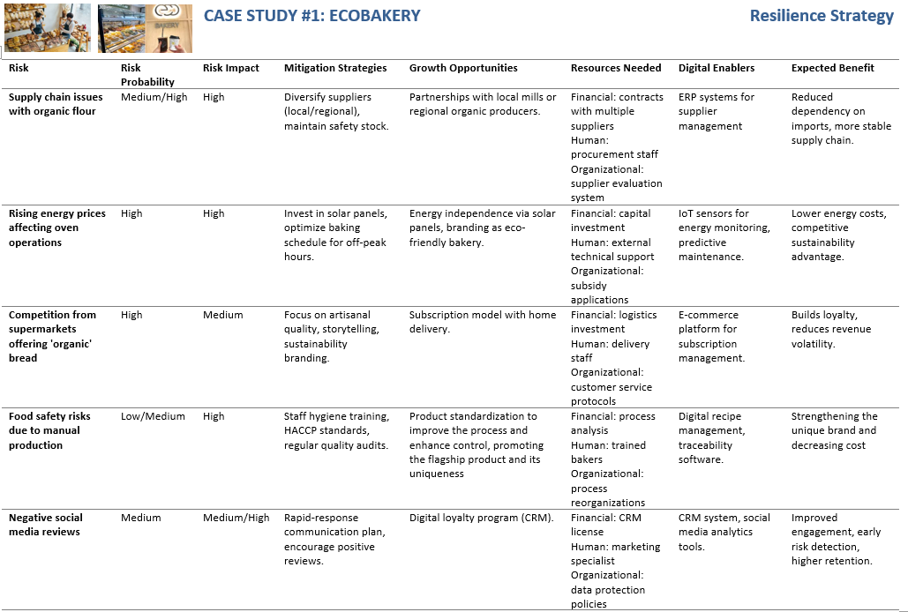
RESULT:
An easy to understand and informative digitally-enabled Resilience strategy
Look at the comprehensive analysis in: CASE STUDY ANALYSIS TEMPLATE_Building Resilience Strategy

Slide 24

Follow our journey
l
in
f
www.DIGIFABS.eu

