Slide 1

ORGANISATIONAL RESILIENCE
Case studies
Funded by the European Union. Views and opinions expressed are however those of the author(s) only and do not necessarily reflect those of the European Union. Neither the European Union nor the granting authority can be held responsible for them

Slide 2
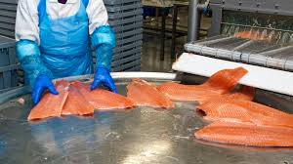
CASE STUDY 2: NordicSeafood (Denmark)
NordicSeafood is a medium-sized company specializing in processing fresh and frozen fish for domestic and export markets. The firm’s main clients are supermarkets and restaurant chains in Germany and the UK. The company is proud of its reputation for high-quality, sustainably sourced products. Yet, it operates in a highly uncertain environment. Brexit has introduced new customs regulations and paperwork, creating delays and higher administrative costs for exports. Climate change is gradually reducing certain fish stocks, making sourcing unpredictable. Food safety is another major concern, as even one contamination incident could damage customer trust and lead to costly recalls. Digitalization has also created new vulnerabilities: customs and logistics documents are increasingly processed online, making the company a potential target for cyberattacks. Finally, NordicSeafood is heavily dependent on a few large supermarket contracts, meaning that the loss of one client could significantly impact revenue.
Contextual challenges with risk relevance:
Brexit-related regulations have already increased paperwork and caused delays. This risk is ongoing and frequent.
Climate change is reducing certain fish stocks, impacting sourcing. This is a long-term but severe risk.
Food safety failures could result in recalls and reputational damage. Historically rare, but potentially catastrophic.
Cyberattacks on export and customs systems are rising across the sector. Moderately likely, with medium to high impact.
Dependence on a few large supermarket clients creates concentration risk. If one contract is lost, the effect is immediate and severe.

Slide 3
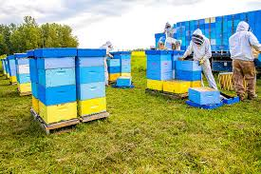
CASE STUDY 3: SweetHive (Poland)
SweetHive is a cooperative of 40 small honey producers spread across rural Poland. Together, they sell honey and related products under one shared brand, mainly through farmers’ markets and small local shops. The cooperative prides itself on being community-driven, supporting sustainable beekeeping practices. However, SweetHive faces mounting challenges. Climate change, particularly hotter summers and pesticide use, is leading to bee colony losses and reducing honey yields. At the same time, the market is flooded with cheap imported honey, some of which is counterfeit, undermining consumer trust in authentic products. Demand is seasonal, with peaks in autumn and winter, leaving producers with uneven cash flow. The cooperative has very limited digital presence, which restricts its ability to reach customers outside of local markets. If they were to expand into online sales, they would also face risks related to data protection and logistics.
Contextual challenges with risk relevance:
Bee colony losses from climate change and pesticide use have already been observed. This is a recurring and increasing problem.
Imported counterfeit honey is common in the EU market. The risk is high and directly undermines consumer trust.
Seasonal demand fluctuations are normal for honey. Predictable but with significant cash flow implications.
Limited digital presence prevents access to wider markets. This is a strategic limitation rather than an immediate threat.
Moving online could expose the cooperative to data and logistics risks. Unlikely in the short term but relevant in the long term.

Slide 4
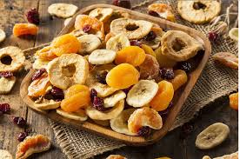
CASE STUDY 4: AgroSnack (Italy)
AgroSnack is a family-owned company producing dried fruit, nut bars, and vegetable chips. Its products are sold across Southern Europe, mainly through supermarkets and fitness retail chains. The company promotes itself as offering healthy, natural, and convenient snacks. However, it operates in a highly competitive sector dominated by multinational brands with much larger marketing budgets. Raw material prices, especially nuts and dried fruit, fluctuate significantly due to global supply dynamics, making cost management difficult. The EU has recently tightened food labelling regulations, requiring producers to clearly state nutritional values, which may force AgroSnack to adjust recipes and packaging. Transport strikes have disrupted distribution in the past, delaying deliveries and damaging relationships with key retail partners. Moreover, the company relies on outdated IT systems, creating risks of data loss or inefficiency in managing orders and inventories.
Contextual challenges with risk relevance:
Global nut and fruit prices fluctuate significantly. This is a recurring and frequent problem.
New EU nutrition labelling rules require compliance. Likely to affect all producers soon.
Competition from multinational brands is strong. This is constant but manageable through differentiation.
Transport strikes in Italy occur occasionally. Disruptive when they happen, but not constant.
Outdated IT systems increase vulnerability to data loss. Quite probable in the near future.

Slide 5
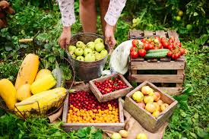
CASE STUDY 5: FreshFields (Netherlands)
FreshFields is a regional supplier of fresh fruit and vegetables, working with schools, restaurants, and local supermarkets in the Netherlands. The company’s success is built on its reputation for freshness and a short supply chain – products are harvested locally and delivered quickly to clients. However, this model brings challenges. Climate variability increasingly affects harvests, making supply less predictable. Rising fuel costs directly impact distribution expenses, as FreshFields runs its own delivery trucks. Fresh produce has a short shelf life, creating the constant risk of food waste and financial losses if demand is lower than expected. Digitalization is both a necessity and a vulnerability: the company uses logistics management software to optimize deliveries, but this makes it a potential target for cyberattacks. Finally, consumer preferences are evolving, with growing demand for exotic fruits that cannot be sourced locally, putting pressure on FreshFields to adapt its product portfolio.
Contextual challenges with risk relevance:
Climate variability is already affecting harvests. Highly probable and increasingly disruptive.
Rising fuel prices directly increase delivery costs. This is an ongoing pressure.
Short shelf life of fresh produce creates a risk of waste. A constant issue in the business model.
Logistics software dependency introduces cyber risks. Less likely but potentially serious.
Changing consumer preferences toward exotic fruits. Likely to grow over time, but impact depends on adaptability.

Slide 6


Follow Our Journey
l
in
f
www.digifabs.eu

