Slide 1
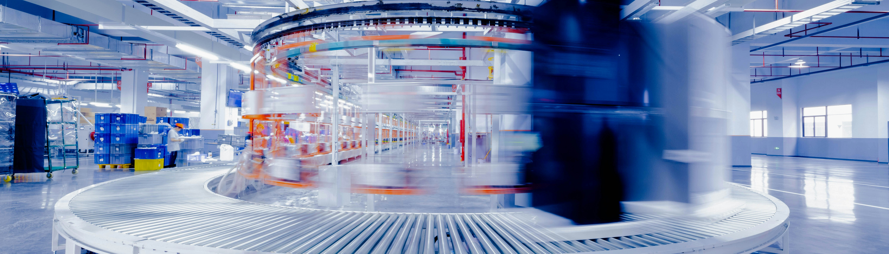
Challenges of F&B Sector
Module overview

Slide 2
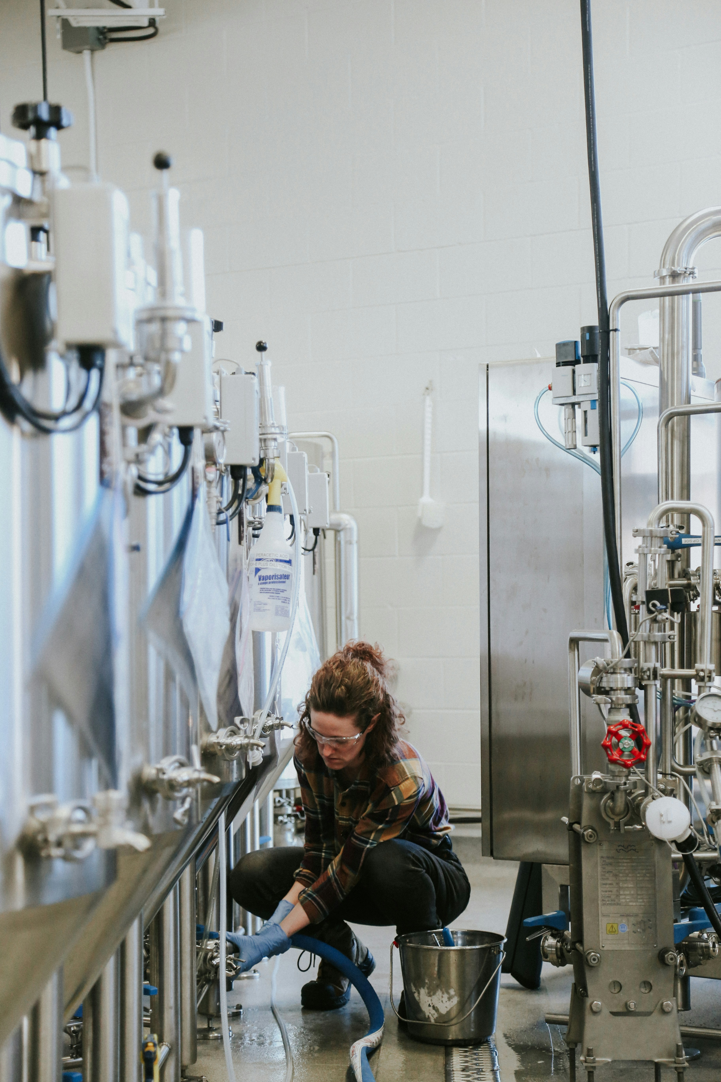
MOOC-ready
resource
ABOUT OUR PROJECT
Objective:
Support SMEs in the Food & Beverage (F&B) sector in adapting to digital transformation
Need for DIGIFABS:
  The F&B sector is the largest manufacturing sector in the EU
  SMEs struggle with adopting new technologies, lagging 20% behind emerging technology potential
  External factors (pandemic, war, climate change, labour changes) highlight the urgency for digital transformation
  Skilled professionals are needed to lead digital change in the sector
Target Audiences:
  Educators: Advance digital skills for teaching and research, driving innovation
  Students: Gain practical experience in digital tools, increasing employability
  SMEs: Improve digital innovation capabilities, competitiveness, and resilience

Slide 3
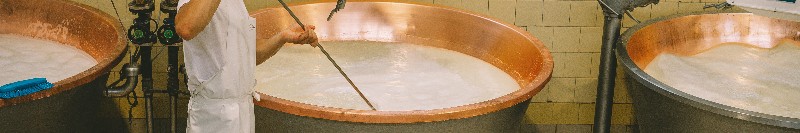
CONTENTS
01
Introduction
02
Challenges of the Food & Beverage Sector
03
Blockchain and traceability systems for the F&B sector
(optional technology track)
04
Who leads the change
05
Conclusion and reflection

Slide 4

01
INTRODUCTION

Slide 5
MOOC-ready
resource
INTRODUCTION
Objective
To empower students and SMEs with the knowledge, skills, and mindset required to successfully navigate and lead digital transformation processes in the Food & Beverage sector
Outcomes
Students gain practical experience in digital transformation tools and methods
SMEs improve digital readiness, innovation capability, and resilience
Educators integrate digital change management into their curricula
Development of Responsible Dynamic Digital Change Agents (RDDCAs)
Enhanced alignment with Industry 5.0 and Society 5.0 goals

Slide 6
How to Use This Module
Use this module as a Bootcamp session, a self-paced MOOC unit, or a classroom discussion resource.
Core path: sector challenges - SME barriers - responsible digital response - first practical action.
Slides marked as OPTIONAL/ADVANCED TRACK provide deeper technology background and can be used selectively.
For non-technical learners, focus on problem-first thinking, SME feasibility and responsible innovation.
Understand
the challenge
Assess
SME barriers
Select
a digital response
Define
a first step

Slide 7


Follow our journey
l
in
f
www.DIGIFABS.eu

