Slide 1
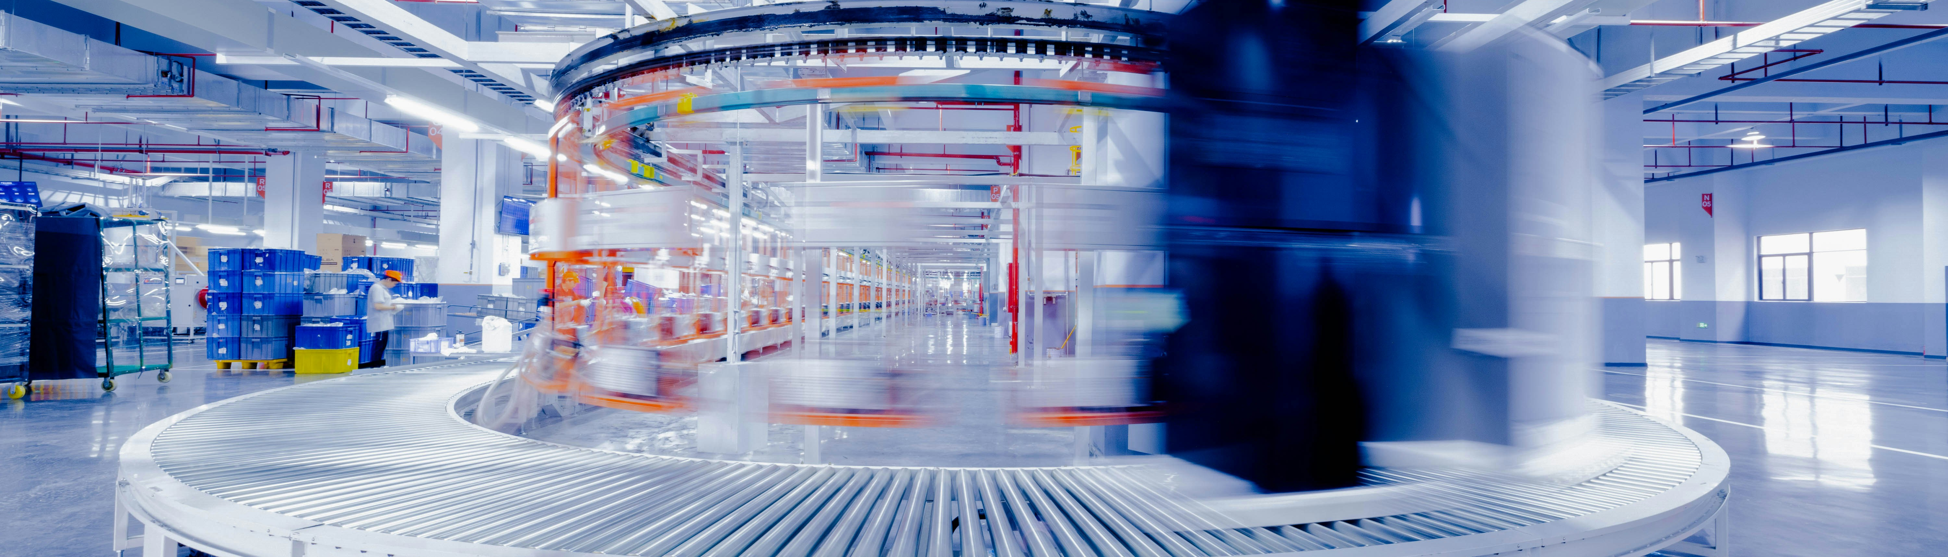
Challenges of F&B Sector
F&B sector challenges and SME context

Slide 2
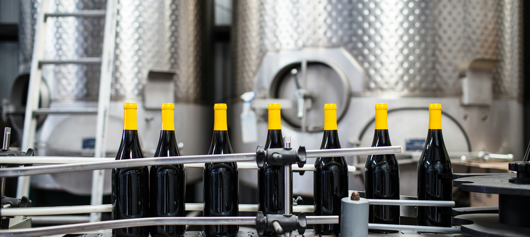
02
Challenges
of F&B sector

Slide 3
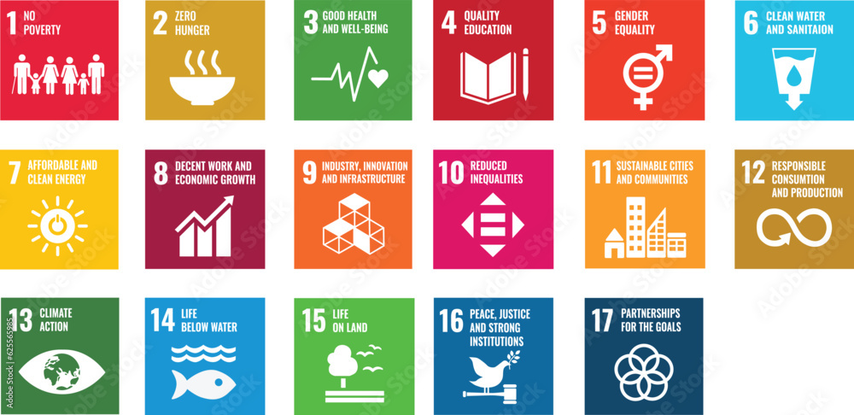
Challenges of F&B Sector
The food and beverage (F&B) sector is one of the most vital and complex industries globally. It spans the entire value chain—from primary production and processing to packaging, logistics, retail, and consumption—employing over 4.5 million people in the EU alone and generating more than €1.1 trillion annually. Beyond its economic footprint, the F&B sector plays a central role in social stability, public health, and environmental impact.
This sector is directly linked to several United Nations Sustainable Development Goals (SDGs), including:
SDG 2: Zero Hunger – by ensuring food security and access
SDG 3: Good Health and Well-being – through nutrition and food safety
SDG 12: Responsible Consumption and Production – by reducing food loss and waste
SDG 13: Climate Action – due to agriculture’s emissions and land use

Slide 4
Current Trends Transforming the F&B Industry
The F&B sector is also particularly exposed to global shocks, such as geopolitical conflicts, pandemics, and climate events. These shocks disrupt supply chains, limit access to raw materials, and increase volatility in food prices. Furthermore, as consumer expectations evolve, the industry is under growing pressure to become more resilient, transparent, and sustainable.
In recent years, the food and beverage sector has undergone a profound transformation driven by changing consumer behavior, scientific advances, and policy shifts. Consumers are increasingly prioritizing health-conscious, sustainable, and personalised food choices, demanding cleaner labels, plant-based alternatives, and traceability of ingredients.

Slide 5
Current Trends Transforming the F&B Industry
At the same time, digitalisation is accelerating across the sector, enabled by technologies such as artificial intelligence, machine learning, blockchain, and IoT. These innovations are being adopted not only to optimise production and logistics but also to meet stricter food safety and labelling regulations. In parallel, climate and biodiversity concerns are pushing companies to rethink their sourcing practices and reduce emissions along the supply chain.
The convergence of health, sustainability, and technology is no longer a future vision—it is a current reality. However, while some large corporations lead the way in innovation, small and medium-sized enterprises (SMEs) often struggle to keep up due to resource constraints, digital skill gaps, and regulatory complexity.

Slide 6
Core Challenges Facing the F&B Sector
This evolving landscape sets the stage for a series of complex challenges. Ensuring food safety and quality while navigating digital transformation and sustainability goals is a demanding task—especially for SMEs.
In the following slides, we explore these core challenges in more depth, with special attention to the role of AI/ML and blockchain technologies as both solutions and sources of disruption.

Slide 7
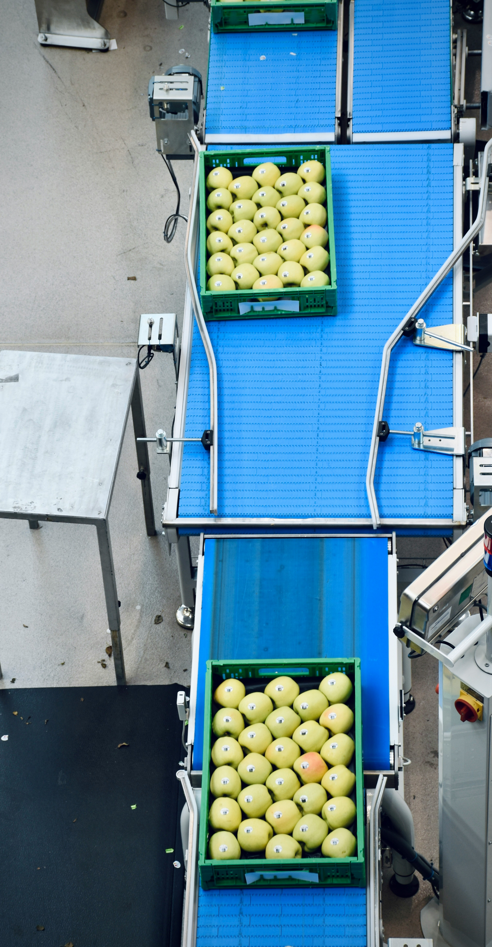
01
Supply Chain Disruptions and Economic Pressures
The F&B sector is grappling with significant supply chain disruptions due to geopolitical conflicts, pandemics, and climate-related events. These disruptions have led to increased costs for raw materials, energy, and transportation, placing financial strain on businesses, especially SMEs. ​
02
Sustainability and Climate Change
Food production is a major contributor to greenhouse gas emissions, accounting for approximately one-third of global emissions. Simultaneously, the sector is vulnerable to climate change impacts like extreme weather events, which threaten agricultural productivity and food security. ​
03
Regulatory Complexity and Consumer Expectations
The F&B industry faces an evolving regulatory landscape with stringent requirements on food safety, labelling, and sustainability. Consumers are increasingly demanding transparency, ethical sourcing, and environmentally friendly practices, compelling companies to adapt rapidly to maintain trust and compliance. ​

Slide 8
Challenge 1:
Supply Chain Disruptions and Economic Pressures
Global food and beverage supply chains are facing unprecedented challenges. Conflicts, such as the war in Ukraine, have disrupted the flow of raw materials, leading to sharp increases in the prices of wheat, oils, and fertilizers.
Simultaneously, climate extremes like droughts and floods are reducing agricultural yields, increasing price volatility, and decreasing the availability of raw materials.​

Slide 9
Challenge 1:
Supply Chain Disruptions and Economic Pressures
Inflation and rising costs of energy and labour are exerting additional pressure on manufacturers' profitability.
Small and medium-sized enterprises (SMEs) are particularly vulnerable, with many facing the risk of insolvency.​
These economic pressures are forcing businesses to reassess their investment strategies and seek ways to enhance the efficiency and resilience of their supply chains.

Slide 10


Follow our journey
l
in
f
www.DIGIFABS.eu

