Slide 1
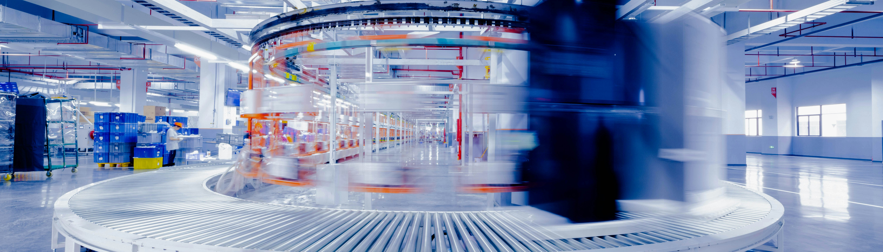
Challenges of F&B Sector
Blockchain and traceability systems - Advanced Track

Slide 2
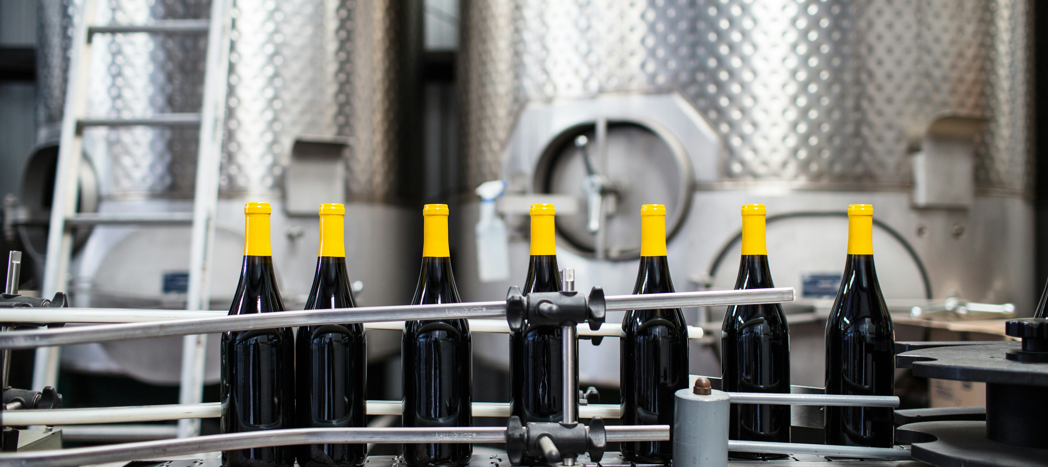
OPTIONAL / ADVANCED TRACK
03
Blockchain and traceability systems for the F&B sector

Slide 3
Facilitator Note: Optional Technology Track
Blockchain and traceability systems
The next section provides additional technical background on blockchain and traceability systems.
Recommended for learners interested in digital technologies, data systems or supply-chain innovation.
For business, SME or mixed groups, simplify the technical explanation and focus on practical value.
Core question: When does a digital tool create real value for an F&B SME?
OPTIONAL / ADVANCED TRACK

Slide 4
OPTIONAL / ADVANCED TRACK
Key terms
Digitalisation: the use of digital technologies to change a business model and provide new revenue and value-producing opportunities.
Internet of Things (IoT): a network of physical devices, vehicles, appliances and other physical objects that are embedded with sensors, software and network connectivity that allows them to collect and share data
Disintermediation: the removal of intermediaries from a supply chain.
Smart contract: a self-executing contract with the terms of the agreement between the two parties being directly written into lines of code.
Greenwashing: the act of providing the public or investors with misleading or outright false information about the environmental impact of a company’s products or operations.

Slide 5
OPTIONAL / ADVANCED TRACK
Definition of a Blockchain
Also known as distributed ledger technology (DLT), the blockchain is a record that anyone can add to, that nobody can change, and that isn't controlled by any one person or entity. The core concept is a public ledger with copies spread out among multiple locations called nodes, which usually refer to individual computers with copies of the ledger.
In other words, a blockchain is a distributed database shared among a computer network's nodes.

Slide 6
OPTIONAL / ADVANCED TRACK
What is Blockchain Technology?
Very often referred as decentralised:
              no one person or entity has control of the information kept in the record
              it’s distributed among the many nodes that make up the network
              to change the record, those changes must first be verified by everyone on the network
              as long as all copies of the record match, the system knows it can update the information
              this increases the difficulty of changing anything stored within the blockchain while building trust in the information that’s recorded

Slide 7
OPTIONAL / ADVANCED TRACK
What is Blockchain Technology?
Blockchain’s decentralised nature also means there’s no single point of failure that could take down the entire database
A company that stores all its clients’ information on a server farm in one building could lose that data if the building were destroyed.
Because a copy of the blockchain exists on every computer on the network at the same time, it can keep working if one or even multiple nodes go offline.

Slide 8
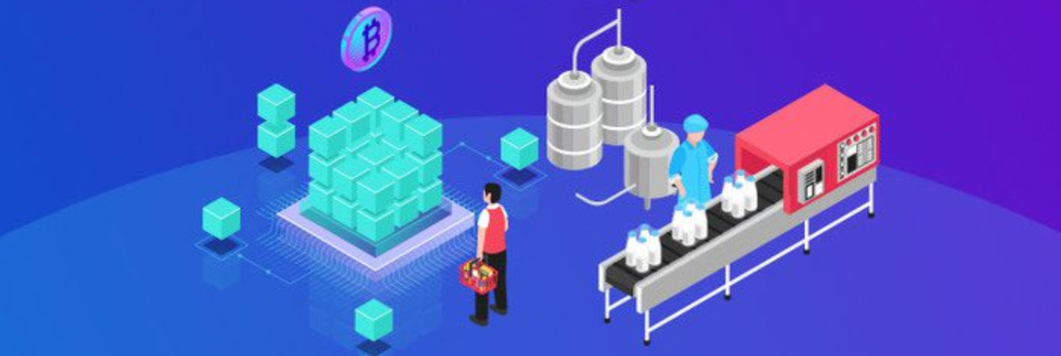
OPTIONAL / ADVANCED TRACK
Blockchain and Agri-food Digitalisation
Best known for their crucial role in cryptocurrency systems for maintaining a secure and decentralised record of transactions
Not limited to cryptocurrency uses
Blockchains can be used to make data in any industry immutable—the term used to describe the inability to be altered.
Notes:
https://101blockchains.com/blockchain-in-food/
https://www.datasciencecentral.com/7-benefits-of-blockchain-development-for-food-industry/

Slide 9
OPTIONAL / ADVANCED TRACK
Blockchain and Agri-food Digitalisation
Digitalisation of Industries
Infrastructure &Rurels of Engagement
AI optimising
IoT data
Notes:
https://101blockchains.com/blockchain-in-food/
https://www.datasciencecentral.com/7-benefits-of-blockchain-development-for-food-industry/

Slide 10
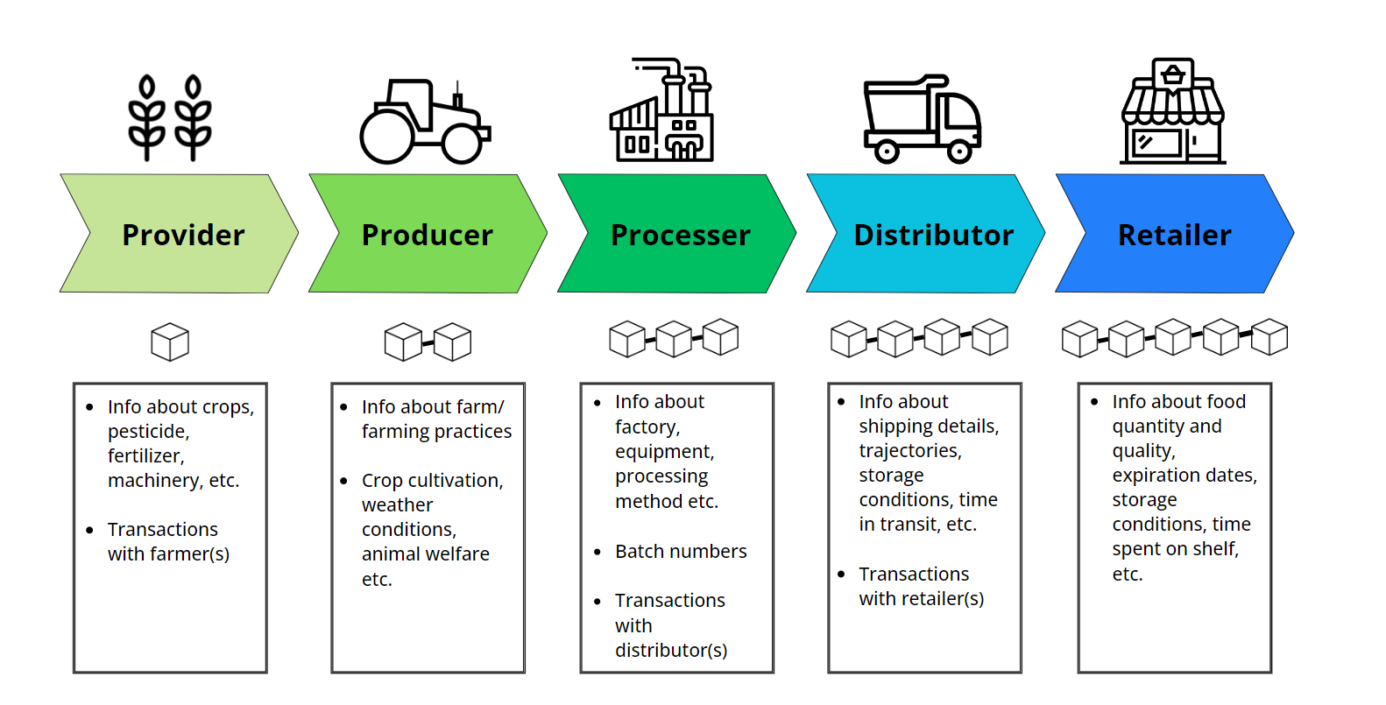
OPTIONAL / ADVANCED TRACK
Blockchain and Agri-food Digitalisation

Slide 11
OPTIONAL / ADVANCED TRACK
Blockchain and Agri-food Digitalisation
Advantages of a Blockchain-supported agrifood supply chain:
  Quicker, more accurate flow of information between supply chain stakeholders
  Disintermediation - a distributed, decentralised ledger where information is verified by all stakeholders removes the need for third-party intermediaries to perform this task, thus cutting out the ‘middleman’
  Less room for human error, data manipulation or miscommunication
  Increased transparency
  Increased efficiency
  Reduced costs

Slide 12
OPTIONAL / ADVANCED TRACK
Blockchain and Agri-food Digitalisation
Increased transparency and traceability thanks to Blockchain can help to reduce the chances of human error and related food waste, but it cannot eliminate all risk of contamination
However, even in instances where Blockchain cannot prevent contamination in the supply chain, it can still help minimize the negative impact
Detailed information about a product’s provenance and journey through the supply-chain can help retailers to identify exactly which products were contaminated, when, and where, in order to conduct a swift and targeted product recall
By increasing supply-chain traceability, Blockchain can help improve food safety and reduce food waste

Slide 13


Follow our journey
l
in
f
www.DIGIFABS.eu

